Slide 1
Agenda for GEOG260/360 GIS & Land Change Models
October 16
See assignment 5
Discuss Assignment 6
October 18
Submit Assignment 6 by 4pm on Canvas
Get instructions for Assignment 7
October 23
Discuss Assignment 7
October 25
Submit Assignment 7 by 4pm on Canvas
Get instructions for Assignment 8

Slide 3
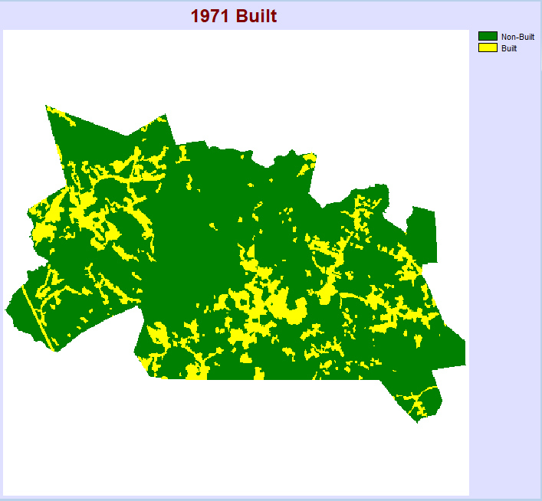
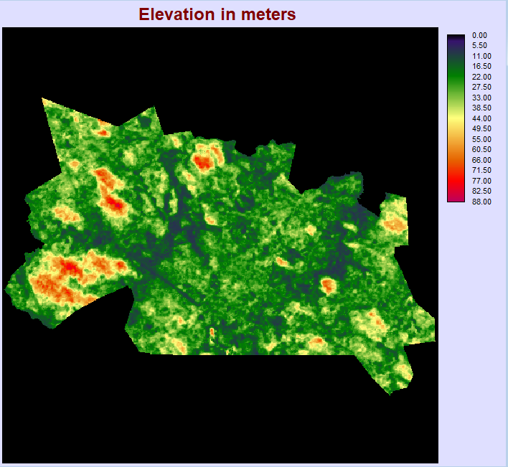
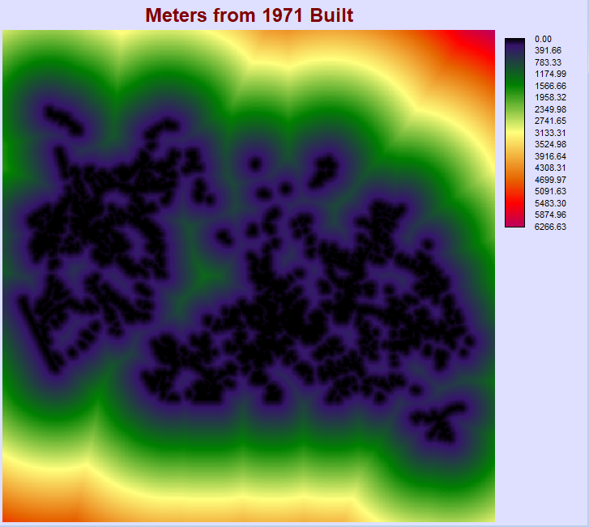
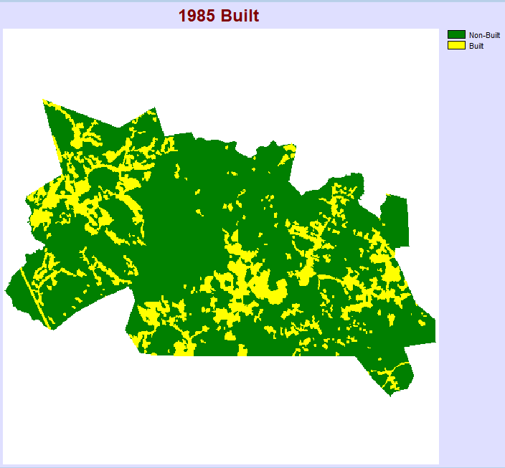
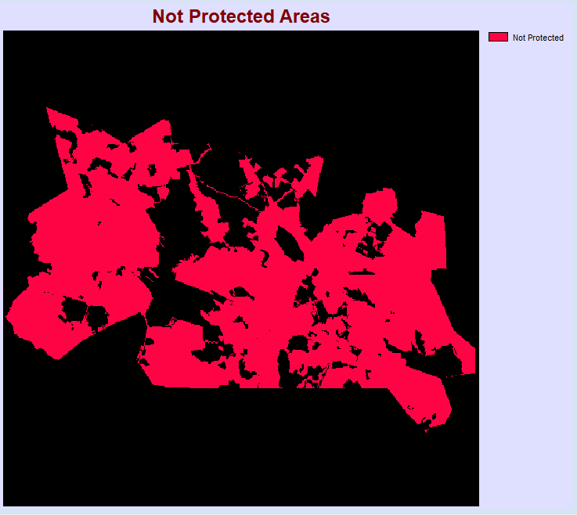
1
3
4
Land Change Modeler Inputs
Earlier Image: Map of 1971 Built Pixels in Yellow and Non-Built in Green (1971Built1)
Later Image: Map of 1985 Built Pixels in Yellow and Non-Built in Green (1985Built1)
Independent Variable 1: Map showing elevation in meters masked to study area (Elevation01)
Independent Variable 2: Map showing distance from 1971 built pixels (1971Built1) created using DISTANCE
Zoning Constraint for Run C: Boolean Map of Nonprotected Areas (Protection01) made with RECLASS
2
5

Slide 4
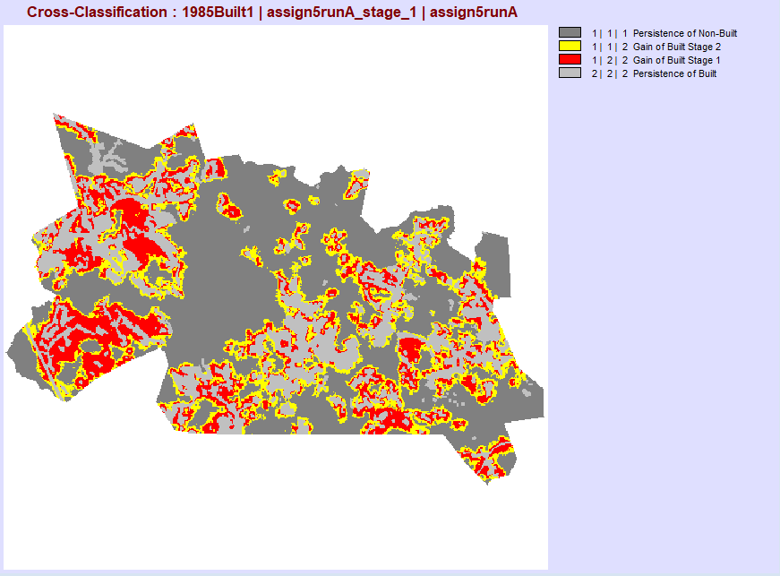
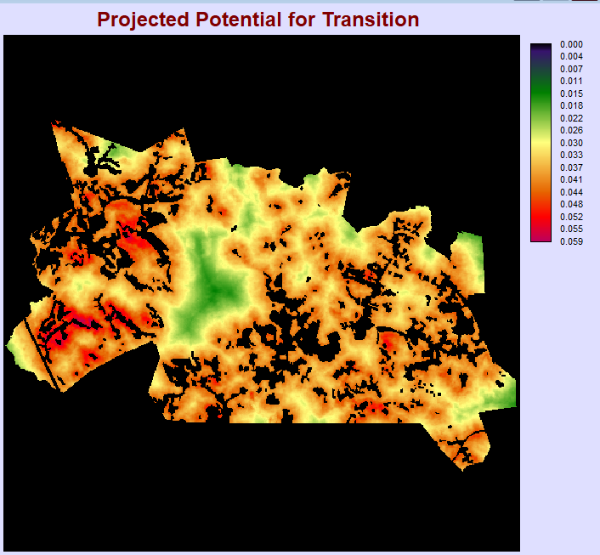
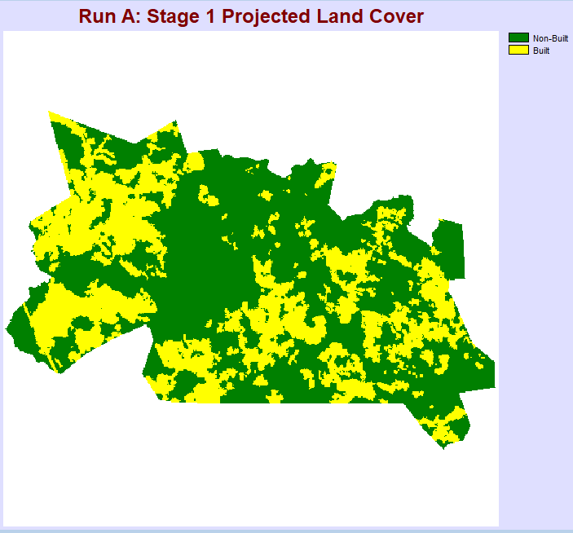
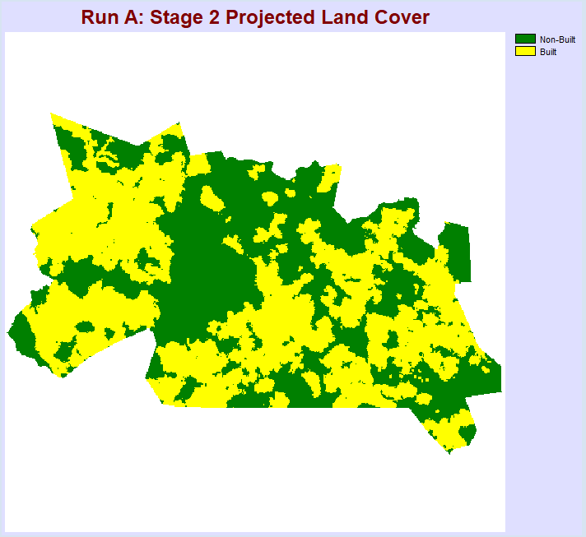
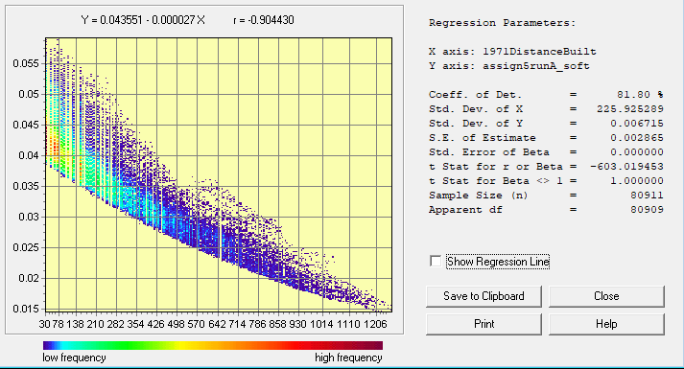
RUN A
Category | Cells | Legend
0 | 158954
1 | 48547 | 1|1|1 Persistence of Non-Built
2 | 16182 | 1|1|2 Gain of Built Stage 2
3 | 16182 | 1|2|2 Gain of Built Stage 1
4 | 22279 | 2|2|2 Persistence of Built
Run A CROSSTAB showing Land Cover in 1985, Simulated Change in 2035, and Simulated Change in 2085
Land Cover Maps
(Stage 1 and 2)
1985-2035
According to the above chart, which was created using the AREA module, 16182 pixels change in each stage. Overall, in the study area, 80911 pixels are non-built in 1985 (calculated by adding persistence of non-built + gain of built stage 2 + gain of built stage 1). We used the Markov matrix to determine the quantity of pixels that will change in the simulation. For all runs, we created the Markov matrix such that 40 percent of the non-built pixels change to built and 60 percent remain non-built. So, 40 percent of the total non-built is 32364. Then, during each stage, half of that changes. So, 16182 is half of that and that many pixels simulated change during each stage. The Markov matrix is the only factor determining quantity of pixels to change, therefore other settings will not impact the quantity, only the allocation.
Run A uses Logistic Regression to create the transition potential map. Logistic Regression is a statistical technique that, with the default settings, produces probabilities of transition that recognize the quantities of past transitions. LCM then uses this transition potential map to allocate the pixels that change from non-built to built in the study region. It does this through analyzing the higher values (higher vulnerability to change) and then allocating the changing pixels there.
2035-2085
Average Values of Projected Transition Potential in 1985 Non-Built Pixels
Category | Average | Legend
1 | 0.036681 | Non-Built at 1985
Light gray indicates pixels that were already built in 1985. Red indicates pixels that became built during stage one (1985-2035). Yellow indicates pixels that became built during stage two (2035-2085). Dark gray indicates pixels that remained Non-Built throughout the simulation.
Average Values of Projected Transition Potential in 1985 Non-Built Pixels
Category | Average | Legend
1 | 0.036681 | Non-Built at 1985
Run A Soft Output Map
Shows the projected potential for transition calculated by the LCM
Using the EXTRACT module, I calculated the average transition potential to be 0.036681. The output of the module is shown above.
A larger average transition potential does not indicate a larger quantity of post-1985 gain of Built. The quantity is determined by the Markov matrix, and the transition potential rather is only concerning allocation of pixels, not quantity.
CROSSTAB Comparing 1985, Stage 1, and Stage 2]

Slide 5
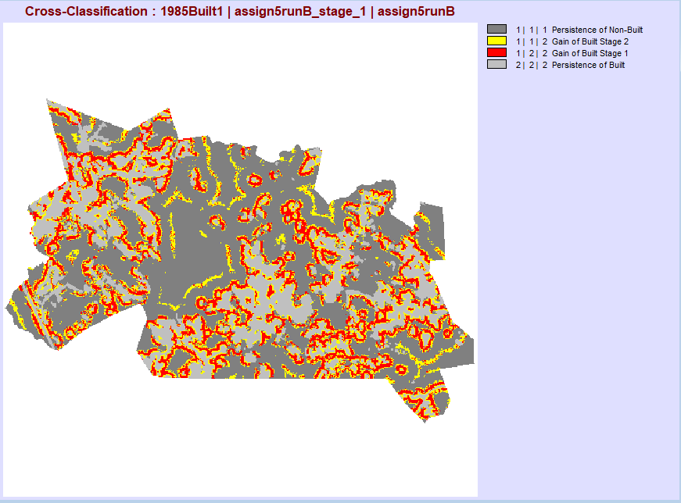
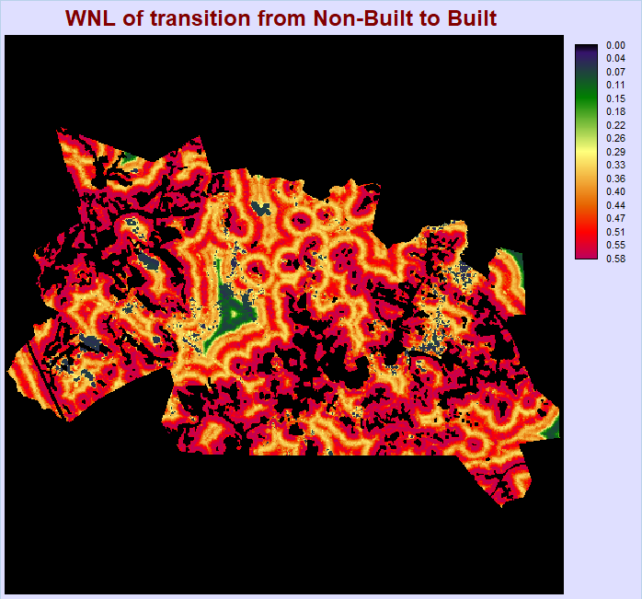
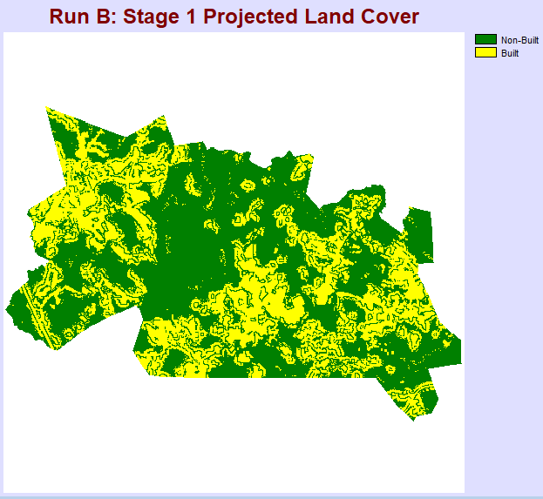
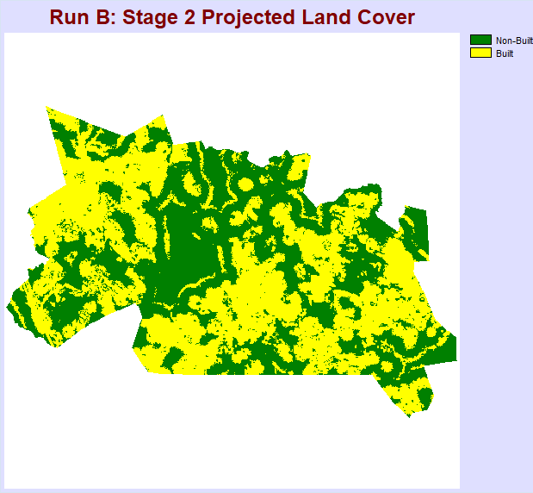
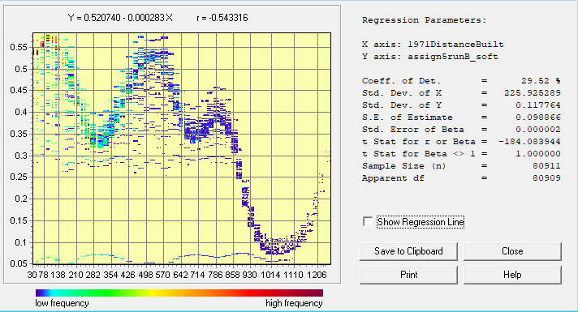
RUN B
Category | Cells | Legend
0 | 158954
1 | 48547 | 1|1|1 Persistence of Non-Built
2 | 16182 | 1|1|2 Gain of Built Stage 2
3 | 16182 | 1|2|2 Gain of Built Stage 1
4 | 22279 | 2|2|2 Persistence of Built
Run B CROSSTAB showing Land Cover in 1985, Simulated Change in 2035, and Simulated Change in 2085
Land Cover Maps
(Stage 1 and 2)
1985-2035
According to the above chart, which was created using the AREA module, 16182 pixels change in each stage. Overall, in the study area, 80911 pixels are non-built in 1985 (calculated by adding persistence of non-built + gain of built stage 2 + gain of built stage 1). We used the Markov matrix to determine the quantity of pixels that will change in the simulation. For all runs, we created the Markov matrix such that 40 percent of the non-built pixels change to built and 60 percent remain non-built. So, 40 percent of the total non-built is 32364. Then, during each stage, half of that changes. So, 16182 is half of that and that many pixels simulated change during each stage. The Markov matrix is the only factor determining quantity of pixels to change, therefore other settings will not impact the quantity, only the allocation.
Run B uses WNL (Weighted Normalized Likelihood) approach to create the transition potential map. WNL uses kernel density and local evaluation in its algorithm to calculate the transition potentials. LCM then uses this transition potential map to allocate the pixels that change from non-built to built in the study region. It does this through analyzing the higher values (higher vulnerability to change) and then allocating the changing pixels there.
2035-2085
Average Values of Projected Transition Potential in 1985 Non-Built Pixels
Category | Average | Legend
1 | 0.448356 | Non-Built at 1985
Light gray indicates pixels that were already built in 1985. Red indicates pixels that became built during stage one (1985-2035). Yellow indicates pixels that became built during stage two (2035-2085). Dark gray indicates pixels that remained Non-Built throughout the simulation.
Average Values of Projected Transition Potential in 1985 Non-Built Pixels
Category | Average | Legend
1 | 0.448356 | Non-Built at 1985
Run B Soft Output Map
Shows the projected potential for transition calculated by the LCM
Using the EXTRACT module, I calculated the average transition potential to be 0.448356. The output of the module is shown above.
A larger average transition potential does not indicate a larger quantity of post-1985 gain of Built. The quantity is determined by the Markov matrix, and the transition potential rather is only concerning allocation of pixels, not quantity.

Slide 6
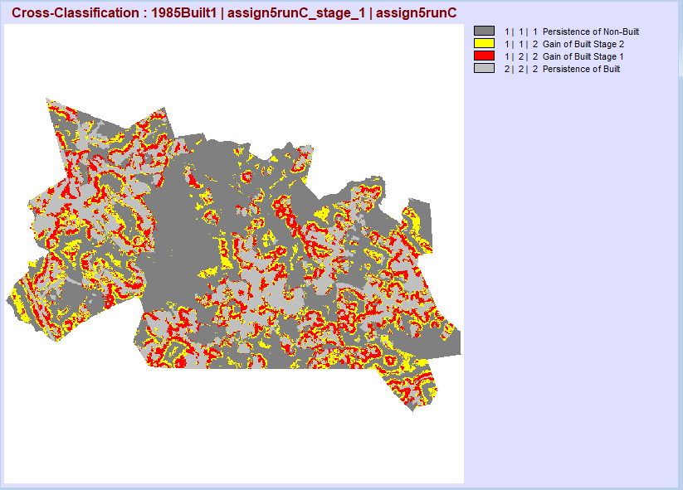
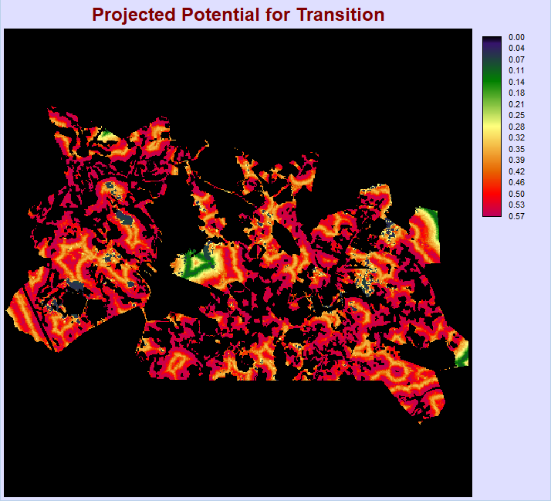
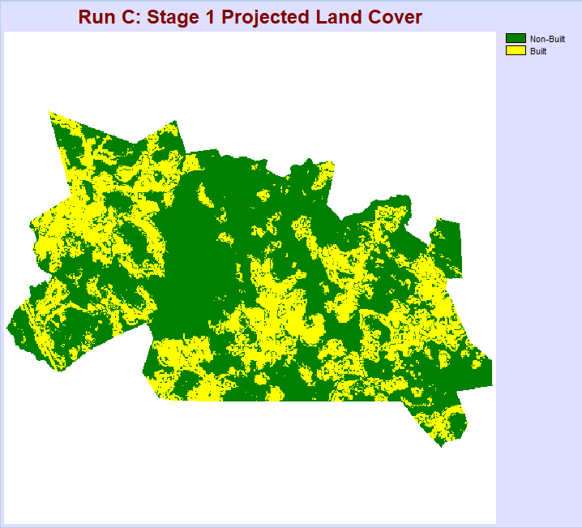
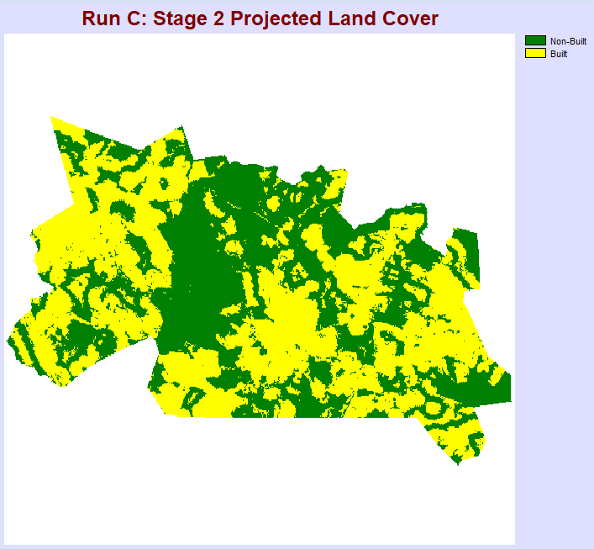
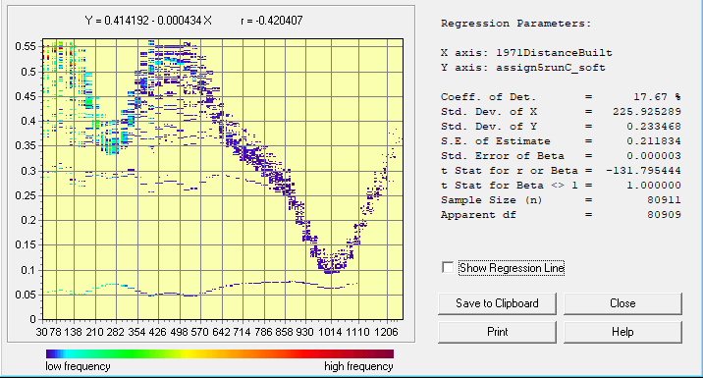
RUN C
Category | Cells | Legend
0 | 158954
1 | 48547 | 1|1|1 Persistence of Non-Built
2 | 16182 | 1|1|2 Gain of Built Stage 2
3 | 16182 | 1|2|2 Gain of Built Stage 1
4 | 22279 | 2|2|2 Persistence of Built
Run C CROSSTAB showing Land Cover in 1985, Simulated Change in 2035, and Simulated Change in 2085
Land Cover Maps
(Stage 1 and 2)
1985-2035
According to the above chart, which was created using the AREA module, 16182 pixels change in each stage. Overall, in the study area, 80911 pixels are non-built in 1985 (calculated by adding persistence of non-built + gain of built stage 2 + gain of built stage 1). We used the Markov matrix to determine the quantity of pixels that will change in the simulation. For all runs, we created the Markov matrix such that 40 percent of the non-built pixels change to built and 60 percent remain non-built. So, 40 percent of the total non-built is 32364. Then, during each stage, half of that changes. So, 16182 is half of that and that many pixels simulated change during each stage. The Markov matrix is the only factor determining quantity of pixels to change, therefore other settings will not impact the quantity, only the allocation.
Run C uses WNL (Weighted Normalized Likelihood) approach to create the transition potential map. WNL uses kernel density and local evaluation in its algorithm to calculate the transition potentials. This run also uses a zoning constraint, namely restricting only to non-protected areas, which automatically makes the values in the transition potential map zero in areas that are protected (which is why this soft output is different from run B). LCM then uses this transition potential map to allocate the pixels that change from non-built to built in the study region. It does this through analyzing the higher values (higher vulnerability to change) and then allocating the changing pixels there.
2035-2085
Average Values of Projected Transition Potential in 1985 Non-Built Pixels
Category | Average | Legend
1 | 0.303152 | Non-Built at 1985
Light gray indicates pixels that were already built in 1985. Red indicates pixels that became built during stage one (1985-2035). Yellow indicates pixels that became built during stage two (2035-2085). Dark gray indicates pixels that remained Non-Built throughout the simulation.
Run C Soft Output Map
Shows the projected potential for transition calculated by the LCM
Using the EXTRACT module, I calculated the average transition potential to be 0.303152. The output of the module is shown above.
A larger average transition potential does not indicate a larger quantity of post-1985 gain of Built. The quantity is determined by the Markov matrix, and the transition potential rather is only concerning allocation of pixels, not quantity.

Slide 7
Maps of Forest, Other, Built

Slide 8
Maps of Forest, Other, Built

Slide 9
Maps of Forest, Other, Built

Slide 10
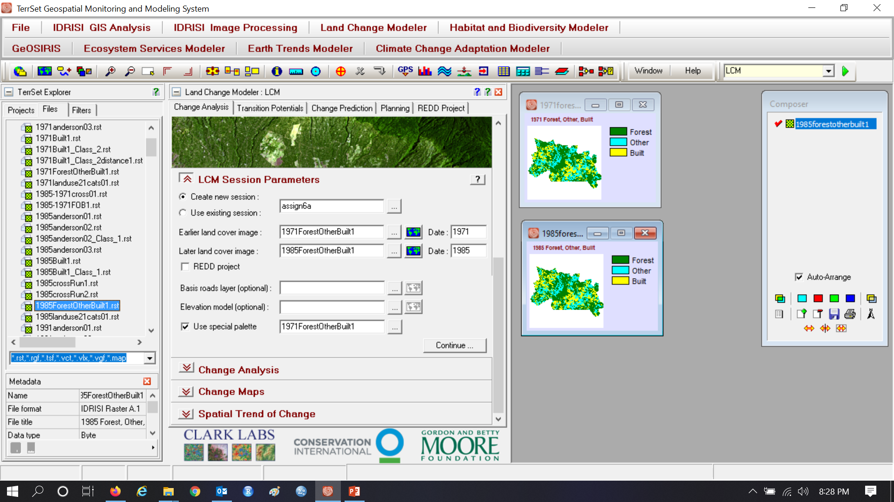
Assignment 6

Slide 11
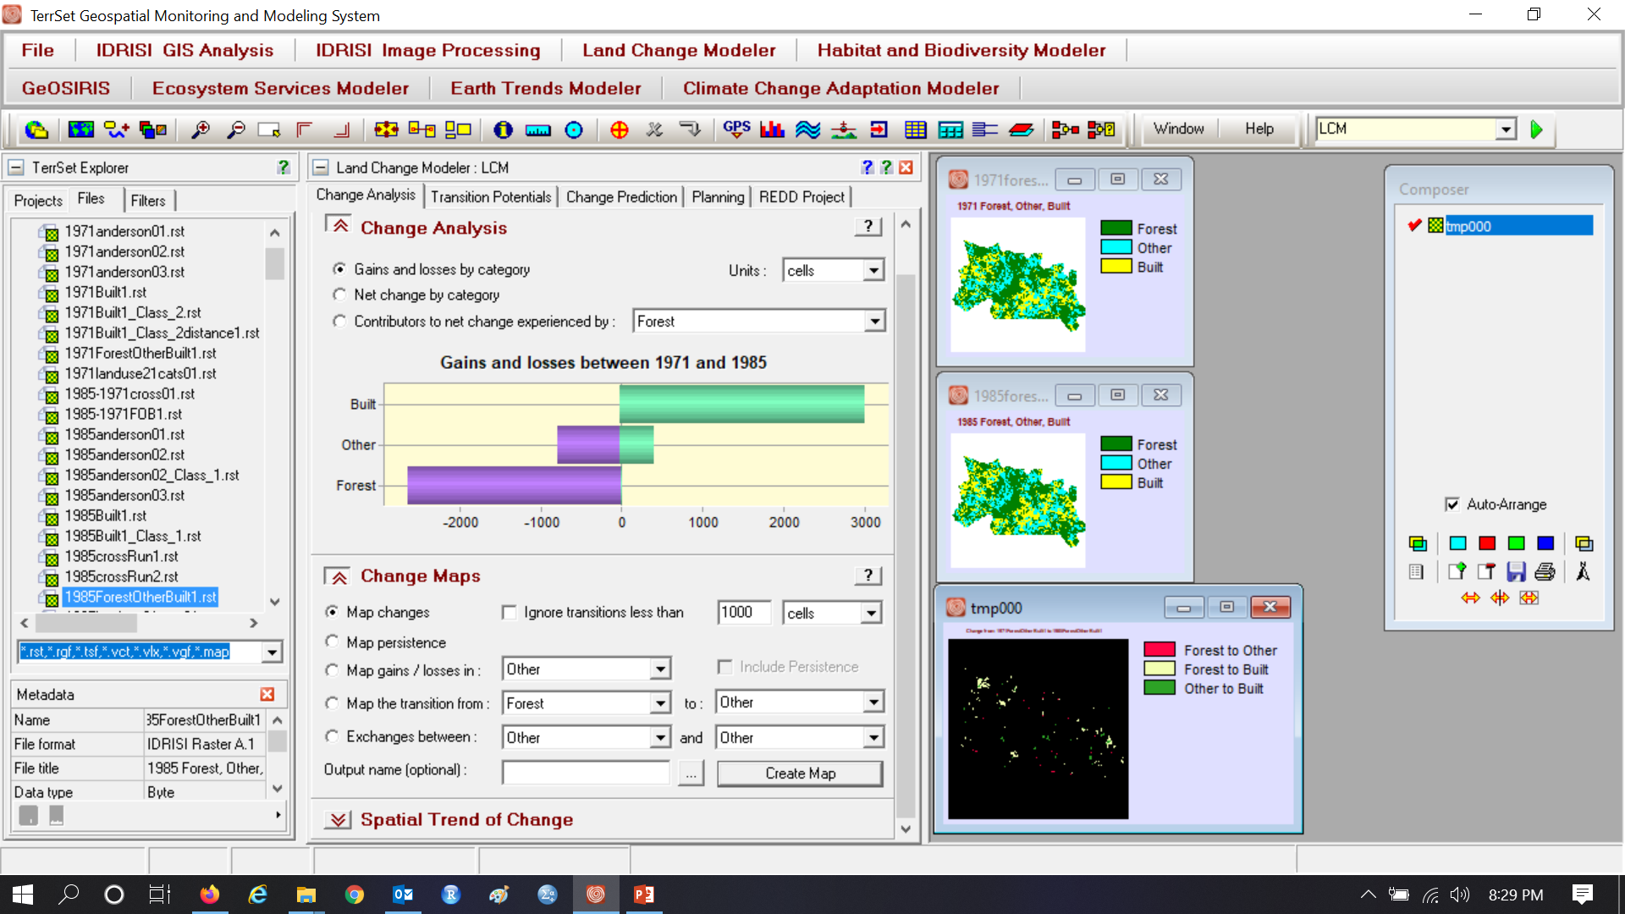
Exactly three transitions are positive

Slide 12
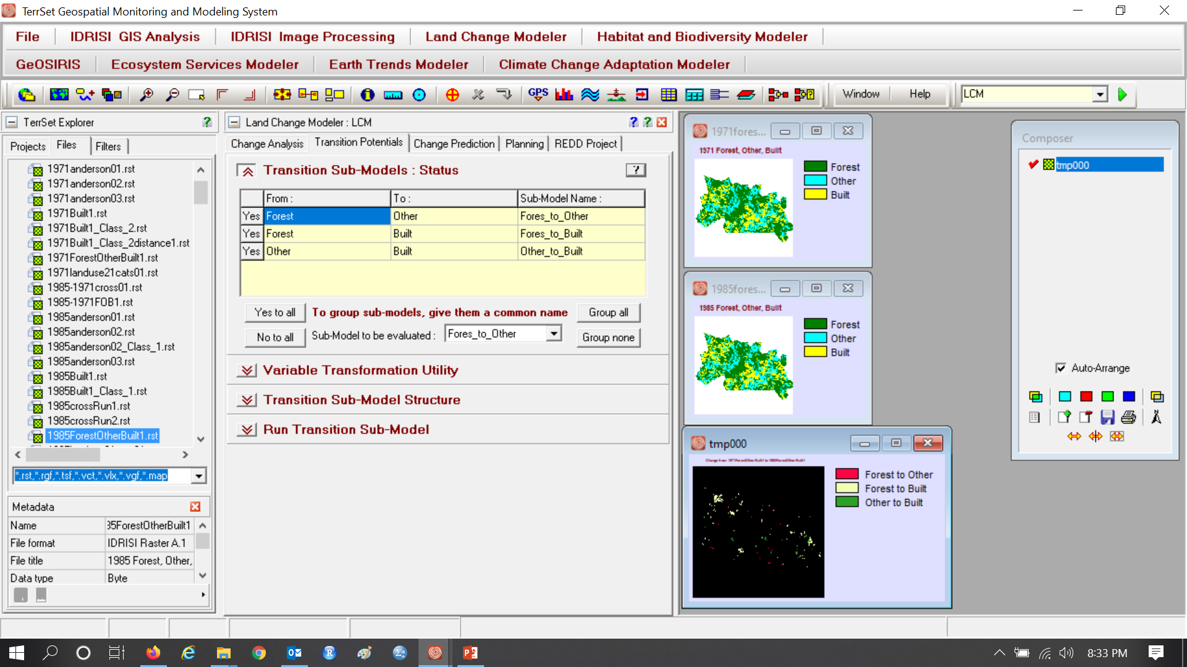
Click Group all, so distance determines all transitions.

Slide 13
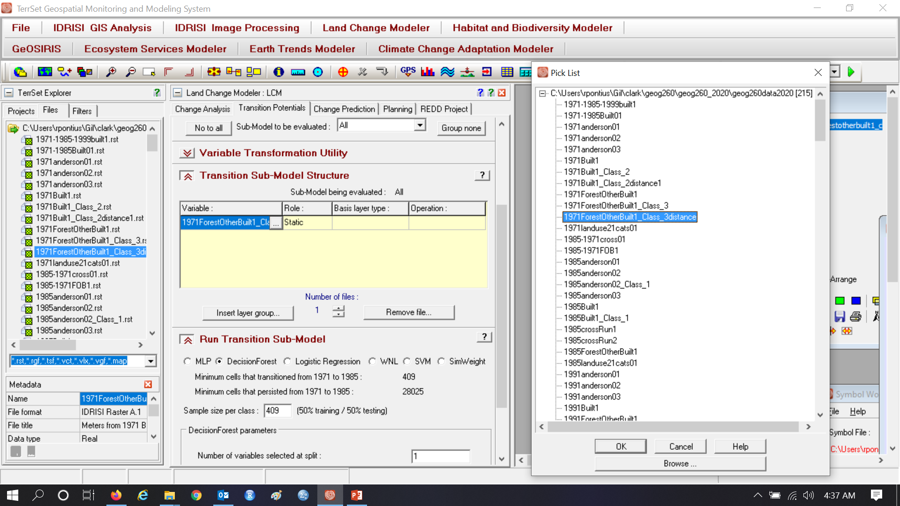
Assignment 6

Slide 14
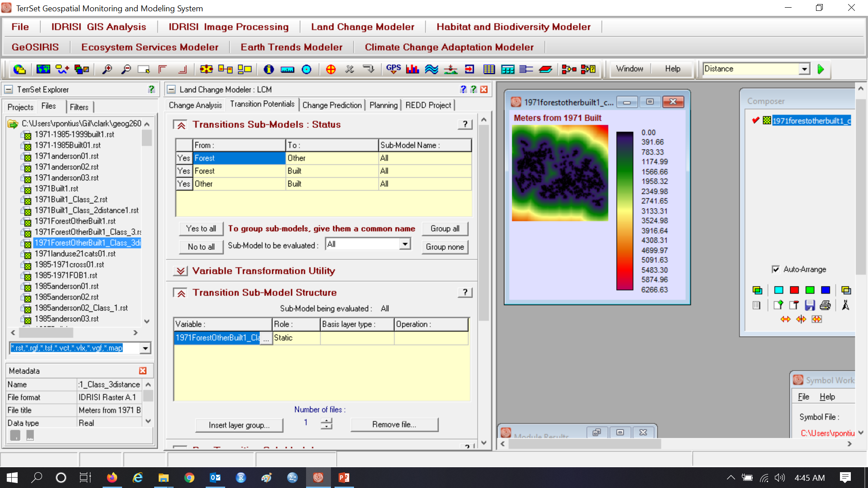
Assignment 6

Slide 15
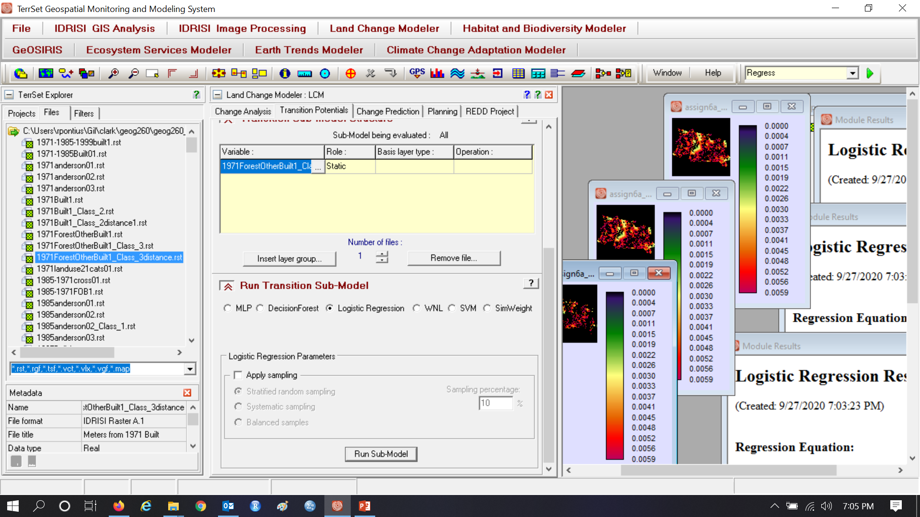
This illustrates Logistic Regression without sampling. Assignment 6 uses SVM and Decision Forest.

Slide 16
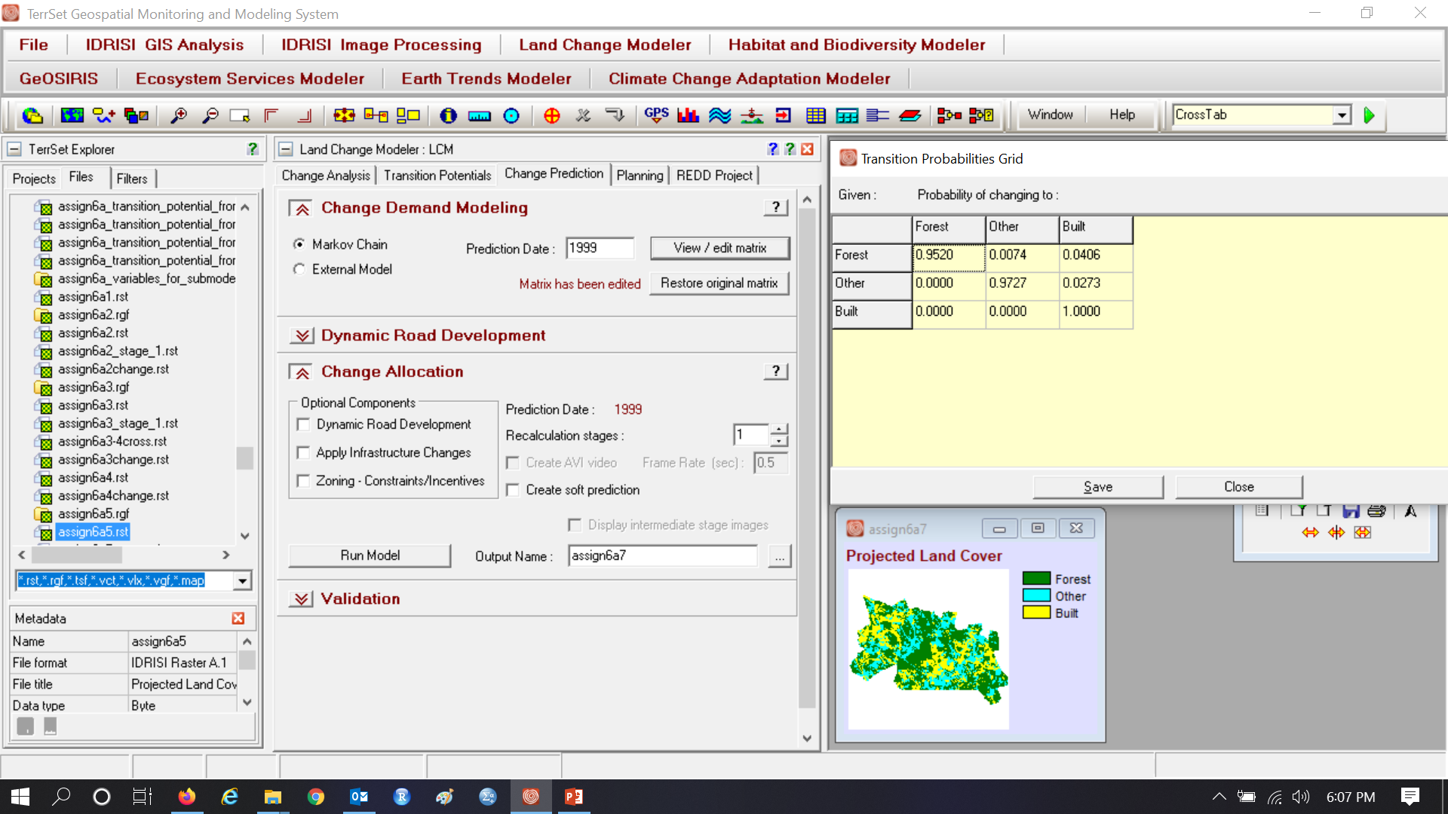
Prediction Date is 1999, which makes the duration of calibration interval the same as the prediction interval

Slide 17
Markov Matrix gives the proportion, not probability, of the earlier category in each row that transitions to a later category in the column. Other and Built compete to gain from Forest.

Slide 18
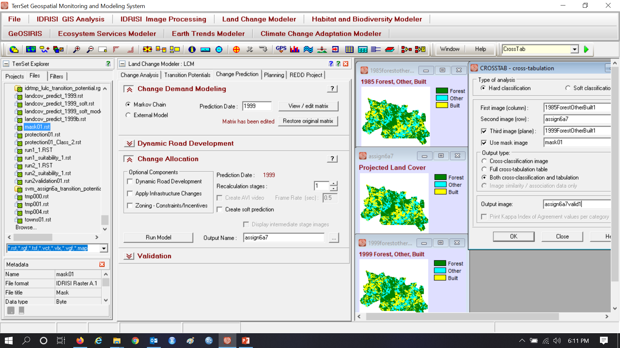
Use CROSSTAB to create validation map

Slide 19
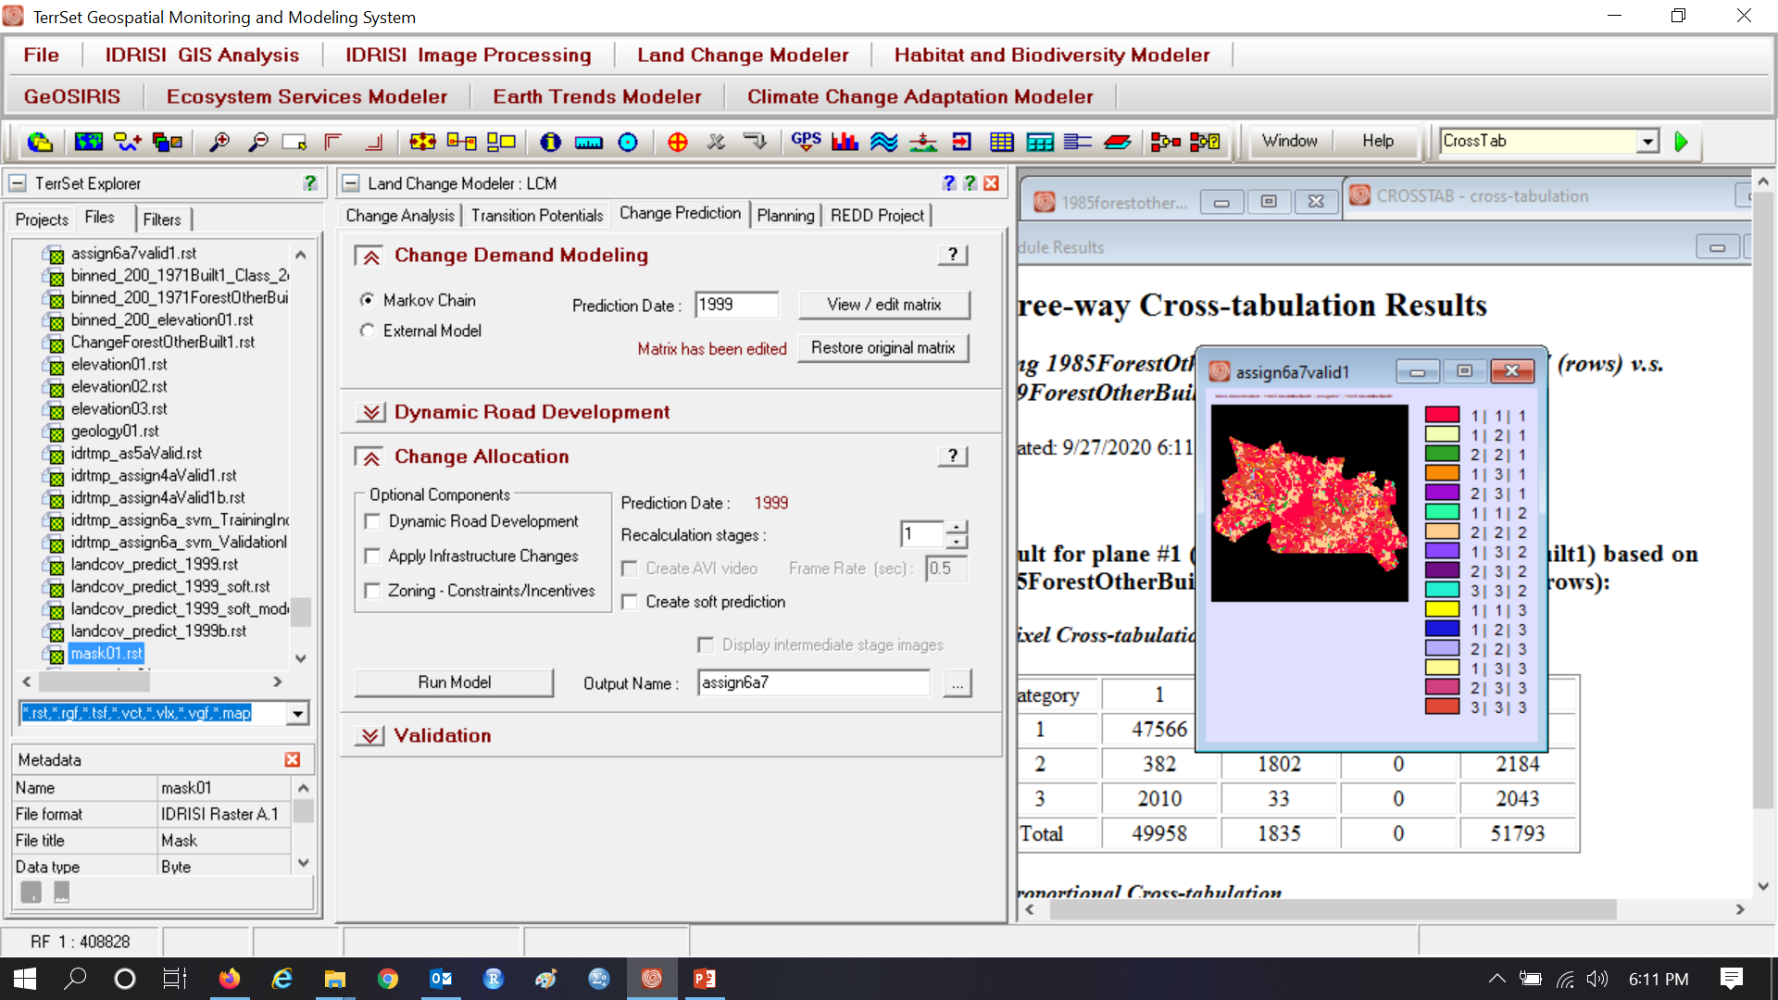
Interpret each combination

Slide 20
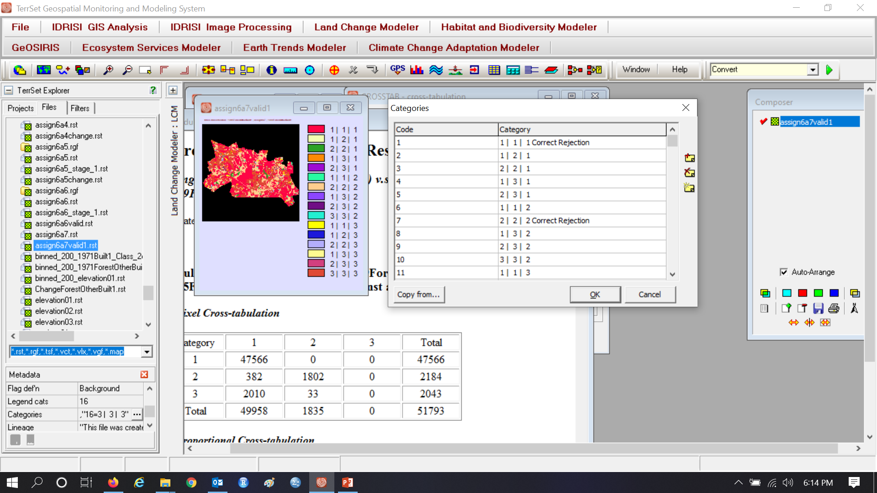
1 | 1 | 1 is a Correct Rejection of Forest 2 | 2 | 2 is a Correct Rejection of what?

Slide 21
This map is validation of simulation that uses Logistic Regression. Wrong Hit is reference change simulated as change to the wrong gaining category. Unpredicted is a transition that exists in the reference change during 1985-1999 but that LCM did not try to predict, perhaps because the transition did not exist during 1971-1985.

Slide 22
Forest to Other transition potential
Start of extrapolation
Positive values are Forest at 1985.
Non-Forest at 1985 is zero.

Slide 23
Forest to Built transition potential
Start of extrapolation
Positive values are Forest at 1985.
Non-Forest at 1985 is zero.

Slide 24
Other to Built transition potential
Start of extrapolation
Positive values are Other at 1985.
Non-Other at 1985 is zero.

Slide 25
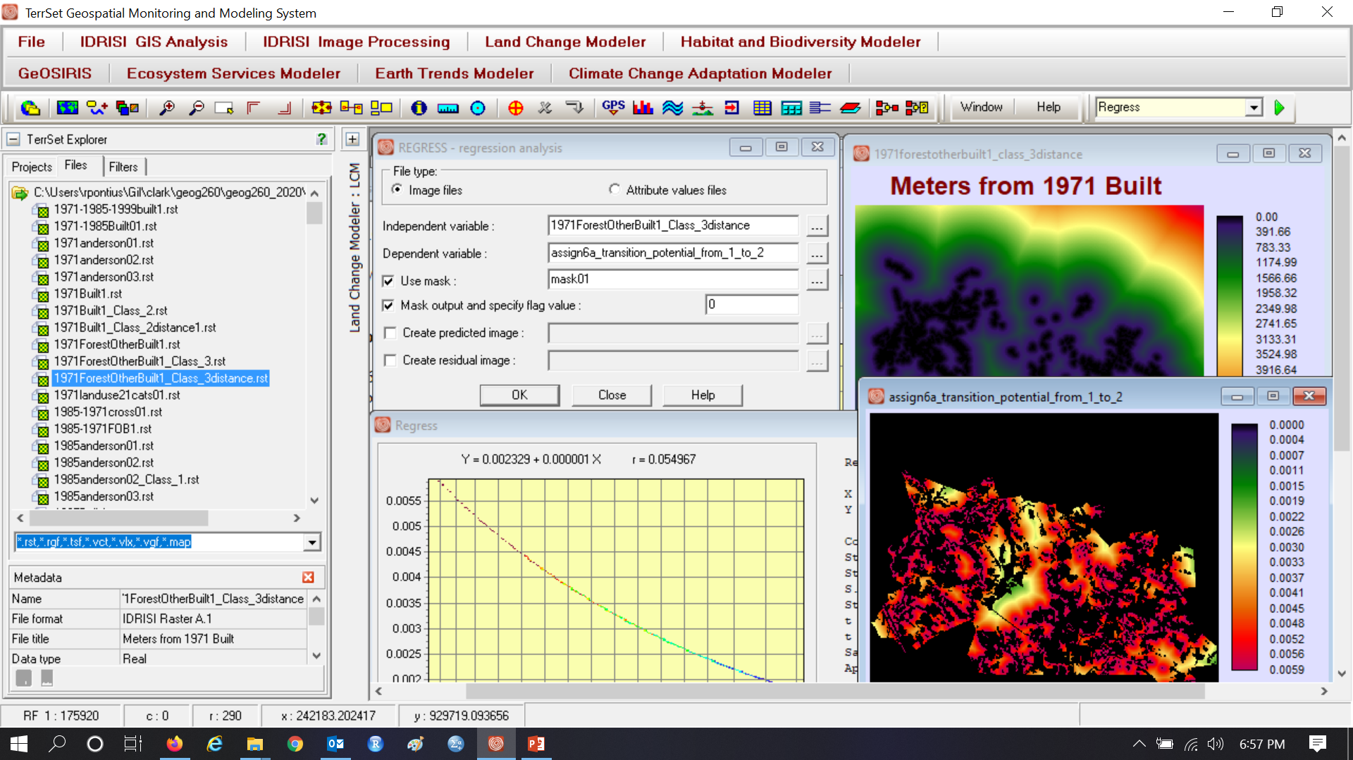
Logistic Regression transition potential from Forest to Other

Slide 26
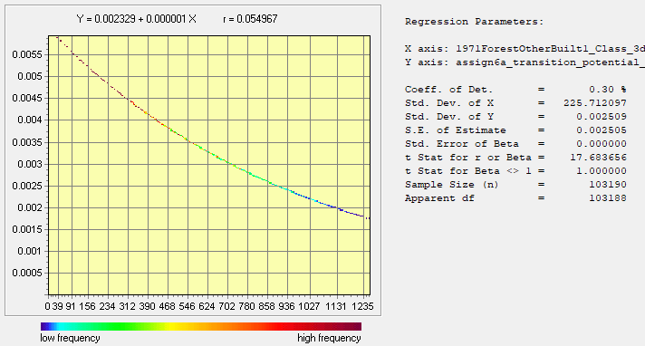
Logistic Regression transition potential from Forest to Other
Transition Potential versus distance
Positive values are Forest at 1985.
Non-Forest at 1985 is zero.

Slide 27
Logistic Regression transition potential from Forest to Built
Transition Potential versus distance
Positive values are Forest at 1985.
Non-Forest at 1985 is zero.

Slide 28

Other to Built transition potentials are zero for 1985 Other. Forest to Built transitional potentials are zero for 1985 Forest.
Transition Potential versus distance
Positive values are Other at 1985.
Non-Other at 1985 is zero.

Slide 29
Definitions of Overfit and Underfit
A mathematical relationship is overfit to the calibration data when the mathematical relationship is specific to the calibration data to a level of detail that is not important for the purpose, which frequently is to extrapolate.
A mathematical relationship is underfit to the calibration data when the mathematical relationship fails to express patterns in the calibration data that are important for the purpose, which frequently is to extrapolate.

Slide 30
Markov Matrix gives the proportion from the category in each row that transitions to a category in the column
The Markov matrix below derives from the calibration interval from 1971 to 1985,
then extrapolates the changes during 1985 to 1999 in terms of proportions of the sizes of the categories at 1985.
Will this generate the same number of pixels of change during each 14-year time interval?

Slide 31
Markov Matrix gives the proportion from the category in each row that transitions to a category in the column
Consider the Markov matrix below and an initial size of 100 for Non-Built and anything for Built.
What is the size of change during the first time interval that begins with 100 for Non-Built?
?
How much Non-Built remains after the first time interval?
?
What is the size of change during the second time interval?
?
How much Non-Built remains after the second time interval?
?
Is change accelerating, decelerating, or remaining constant?
 | To Non-Built | To Built
From Non-Built | 0.9 | 0.1
From Built | 0.0 | 1.0

Slide 32
Markov Matrix gives the proportion from the category in each row that transitions to a category in the column
Consider the Markov matrix below and an initial size of 100 for Non-Built and anything for Built.
What is the size of change during the first time interval that begins with 100 for Non-Built?
Size of change is 100 times 0.1 = 10.
How much Non-Built remains after the first time interval?
90
What is the size of change during the second time interval?
Size of change is 90 times 0.1 = 9.
How much Non-Built remains after the first time interval?
81
Is change accelerating, decelerating, or remaining constant? decelerating
 | To Non-Built | To Built
From Non-Built | 0.9 | 0.1
From Built | 0.0 | 1.0

Slide 33
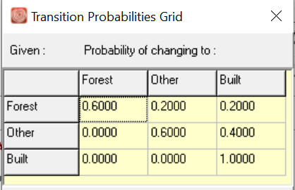
Compute transition sizes starting at 2020 using a Markov matrix with a 10-year time interval
 |  | 2030 | 2030 | 2030
 |  | Forest | Other | Built | Sum
2020 | Forest | 0.6*400 = 240 | 0.2*400 = 80 | 0.2*400 = 80 | 400
2020 | Other | 0.0*400 = 0 | 0.6*400 = 240 | 0.4*400 = 160 | 400
2020 | Built | 0.0*200 = 0 | 0.0*200 = 0 | 1.0*200 = 200 | 200
 | Sum | 240 | 320 | 440 | 1000
Size of change from 2020 to 2030 is what?

Slide 34
Compute transition sizes starting at 2020 using a Markov matrix with a 10-year time interval
 |  | 2030 | 2030 | 2030
 |  | Forest | Other | Built | Sum
2020 | Forest | 0.6*400 = 240 | 0.2*400 = 80 | 0.2*400 = 80 | 400
2020 | Other | 0.0*400 = 0 | 0.6*400 = 240 | 0.4*400 = 160 | 400
2020 | Built | 0.0*200 = 0 | 0.0*200 = 0 | 1.0*200 = 200 | 200
 | Sum | 240 | 320 | 440 | 1000
Size of change from 2020 to 2030 is 80 + 80 + 160 = 320.

Slide 35
Compute transition sizes starting at 2020 using a Markov matrix with a 10-year time interval
 |  | 2030 | 2030 | 2030
 |  | Forest | Other | Built | Sum
2020 | Forest | 0.6*400 = 240 | 0.2*400 = 80 | 0.2*400 = 80 | 400
2020 | Other | 0.0*400 = 0 | 0.6*400 = 240 | 0.4*400 = 160 | 400
2020 | Built | 0.0*200 = 0 | 0.0*200 = 0 | 1.0*200 = 200 | 200
 | Sum | 240 | 320 | 440 | 1000
Size of change from 2020 to 2030 is 80 + 80 + 160 = 320.
 |  | 2040 | 2040 | 2040
 |  | Forest | Other | Built | Sum
2030 | Forest |  |  |  | 240
2030 | Other |  |  |  | 320
2030 | Built |  |  |  | 440
 | Sum |  |  |  | 1000

Slide 36
Compute transition sizes starting at 2020 using a Markov matrix with a 10-year time interval
 |  | 2030 | 2030 | 2030
 |  | Forest | Other | Built | Sum
2020 | Forest | 0.6*400 = 240 | 0.2*400 = 80 | 0.2*400 = 80 | 400
2020 | Other | 0.0*400 = 0 | 0.6*400 = 240 | 0.4*400 = 160 | 400
2020 | Built | 0.0*200 = 0 | 0.0*200 = 0 | 1.0*200 = 200 | 200
 | Sum | 240 | 320 | 440 | 1000
Size of change from 2020 to 2030 is 80 + 80 + 160 = 320.
Size of change from 2030 to 2040 = ?
 |  | 2040 | 2040 | 2040
 |  | Forest | Other | Built | Sum
2030 | Forest | 0.6*240 = 144 | 0.2*240 = 48 | 0.2*240 = 48 | 240
2030 | Other | 0.0*320 = 0 | 0.6*320 = 192 | 0.4*320 = 128 | 320
2030 | Built | 0.0*440 = 0 | 0.0*440 = 0 | 1.0*440 = 440 | 440
 | Sum | 144 | 220 | 616 | 1000

Slide 37
Compute transition sizes starting at 2020 using a Markov matrix with a 10-year time interval
 |  | 2030 | 2030 | 2030
 |  | Forest | Other | Built | Sum
2020 | Forest | 0.6*400 = 240 | 0.2*400 = 80 | 0.2*400 = 80 | 400
2020 | Other | 0.0*400 = 0 | 0.6*400 = 240 | 0.4*400 = 160 | 400
2020 | Built | 0.0*200 = 0 | 0.0*200 = 0 | 1.0*200 = 200 | 200
 | Sum | 240 | 320 | 440 | 1000
Size of change from 2020 to 2030 is 80 + 80 + 160 = 320.
Size of change from 2030 to 2040 is 48 + 48 + 128 = 224. Which category at 2020 changes during both time intervals?
 |  | 2040 | 2040 | 2040
 |  | Forest | Other | Built | Sum
2030 | Forest | 0.6*240 = 144 | 0.2*240 = 48 | 0.2*240 = 48 | 240
2030 | Other | 0.0*320 = 0 | 0.6*320 = 192 | 0.4*320 = 128 | 320
2030 | Built | 0.0*440 = 0 | 0.0*440 = 0 | 1.0*440 = 440 | 440
 | Sum | 144 | 220 | 616 | 1000

Slide 38
Compute transition sizes starting at 2020 using a Markov matrix with a 10-year time interval
 |  | 2030 | 2030 | 2030
 |  | Forest | Other | Built | Sum
2020 | Forest | 0.6*400 = 240 | 0.2*400 = 80 | 0.2*400 = 80 | 400
2020 | Other | 0.0*400 = 0 | 0.6*400 = 240 | 0.4*400 = 160 | 400
2020 | Built | 0.0*200 = 0 | 0.0*200 = 0 | 1.0*200 = 200 | 200
 | Sum | 240 | 320 | 440 | 1000
Size of change from 2020 to 2030 is 80 + 80 + 160 = 320.
Size of change from 2030 to 2040 is 48 + 48 + 128 = 224. Forest 2020 transitions to Other 2030 then Other 2030 transitions to Built 2040.
 |  | 2040 | 2040 | 2040
 |  | Forest | Other | Built | Sum
2030 | Forest | 0.6*240 = 144 | 0.2*240 = 48 | 0.2*240 = 48 | 240
2030 | Other | 0.0*320 = 0 | 0.6*320 = 192 | 0.4*320 = 128 | 320
2030 | Built | 0.0*440 = 0 | 0.0*440 = 0 | 1.0*440 = 440 | 440
 | Sum | 144 | 220 | 616 | 1000

Slide 39
A student wrote:
As we go through both GEOMOD and LCM it seems pretty clear that some more advanced quantity defining or quantity related tools could be helpful. I’m curious what ideas you have for more mathematically or data utilization-involved methods could be used.

Slide 40
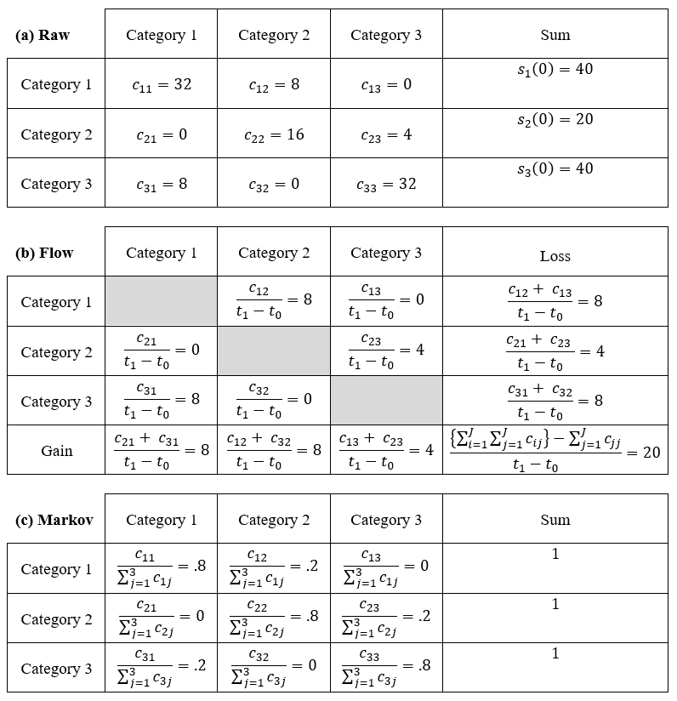
Flow versus Markov Extrapolation
Raw data are the source of the calculation for both Flow and Markov matrices. Both matrices extrapolate beyond the second time point of the Raw data.
Flow matrix assumes each transition has a constant size per time during the extrapolation through continuous future time.
Markov assumes each transition is a constant proportion of the losing category at the start of each time interval across incremental steps of future time.

Slide 41
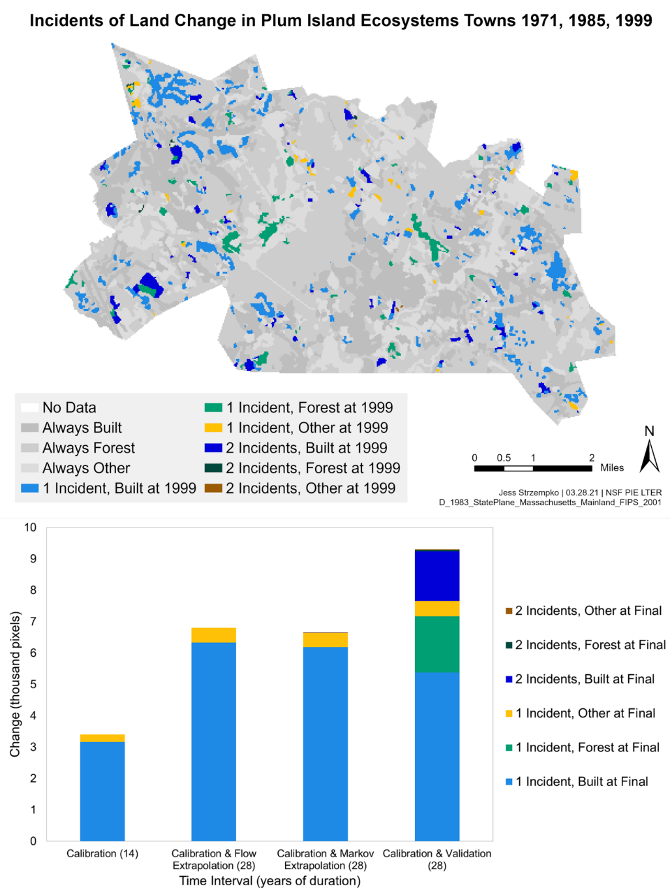
Both matrices are slower than the real suburban change
Bars show cumulative number incidents in each pixel during two time intervals along with the category at the end of the second time interval for categories Built, Forest, and Other.

